Slide 1
Denoising Diffusion Probabilistic Models
NIPS 2020
Jonathan Ho, Ajay Jain, Pieter Abbeel
Presented by Beomsoon Park
C&I LAB

Slide 2
Contents
Introduction
Background
Diffusion Models and Denoising Autoencoders
Experiments
C&I LAB

Slide 3
Introduction
C&I LAB

Slide 4
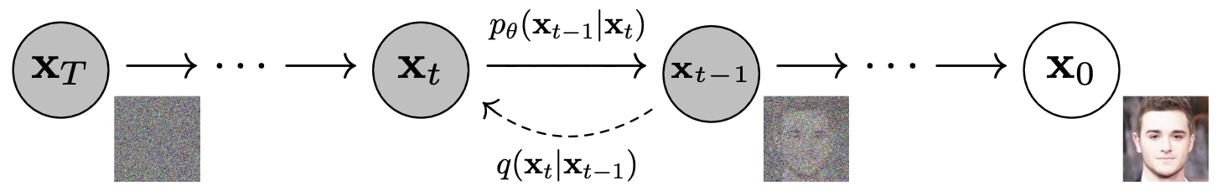
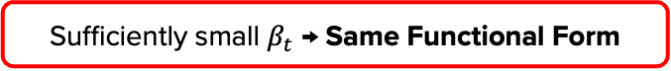
Introduction
Diffusion model (Recap)
Gaussian Noise
Sufficiently small $β_{t}$ → Same Functional Form
Reverse Process
Forward Process
C&I LAB

Slide 5
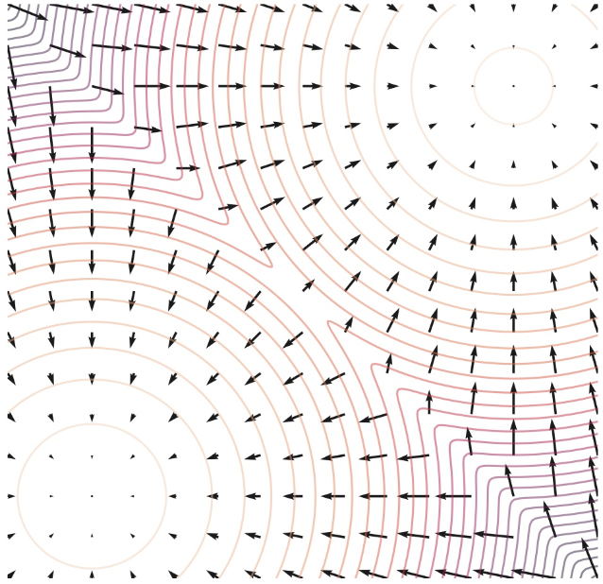
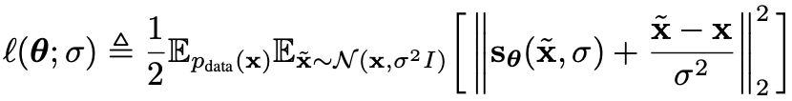
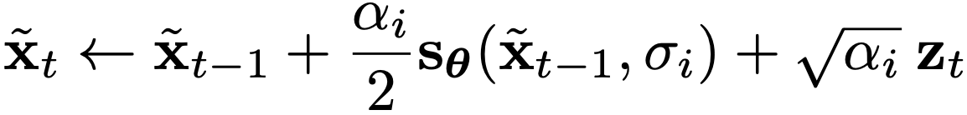
Introduction
Noise Conditional Score Networks (Recap)
Denoising Score Matching
Annealed Langevin Dynamics
C&I LAB

Slide 6


Introduction
Suggestion for New Diffusion model
Diffusion Model
Training
$$≈$$
Denoising Score Matching
Sampling
$$≈$$
Parameterization
Annealed Langevin Dynamics
C&I LAB

Slide 7
Background
C&I LAB

Slide 8
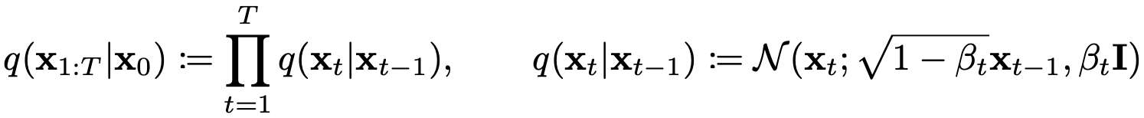
Background
Training in Diffusion Model
Following Gaussian Distribution
C&I LAB

Slide 9
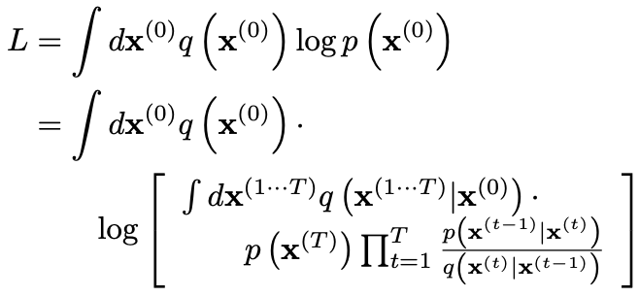
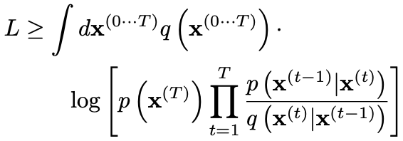
Background
Training in Diffusion Model
(Jensen’s Inequality)
C&I LAB

Slide 10
Background
Objective Function
All posteriors have become conditional to $x_{0}$
Objective function becomes tractable
C&I LAB

Slide 11
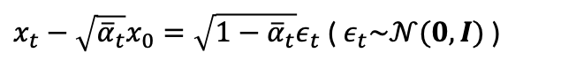

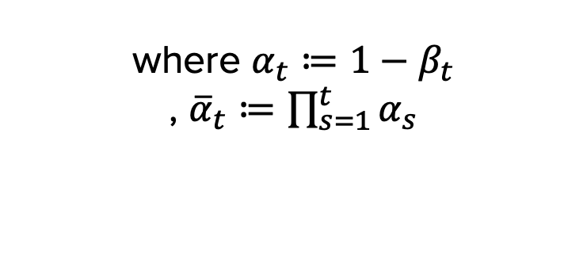
Background
Derivation of $q(x_{t}|x_{0})$ & $q(x_{t−1}|x_{t},x_{0})$
where $α_{t}≔1−β_{t}$
, ${\overline{α}}_{t}≔\prod_{s=1}^{t}{α_{s}}$
$x_{t}−\sqrt{{\overline{α}}_{t}}x_{0}=\sqrt{{1−\overline{α}}_{t}}ε_{t}$ ( $ε_{t}\sim 𝒩(0,I)$ )
$$x_{t}=\sqrt{{\overline{α}}_{t}}x_{0}+\sqrt{{1−\overline{α}}_{t}}ε_{t}$$
C&I LAB

Slide 12
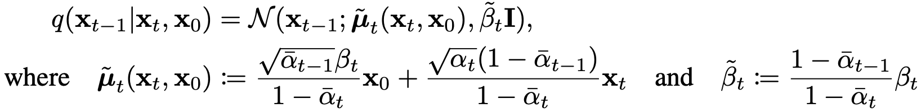
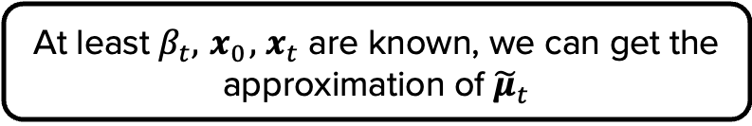
Background
Derivation of $q(x_{t}|x_{0})$ & $q(x_{t−1}|x_{t},x_{0})$
At least $β_{t}, { x}_{0},{ x}_{t}$ are known, we can get the approximation of ${\tilde{μ}}_{t}$
C&I LAB

Slide 13
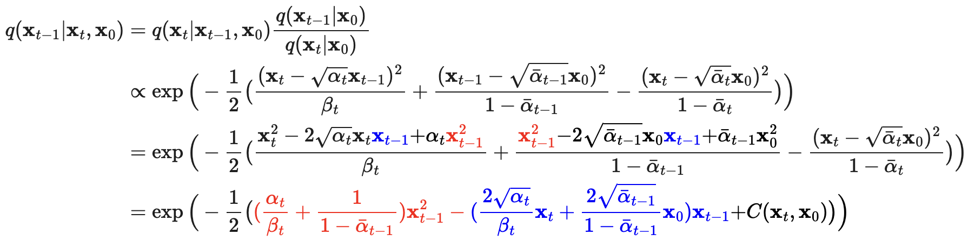
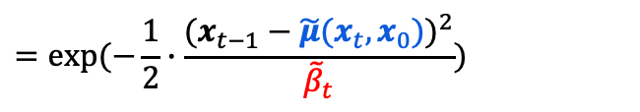
Background
Derivation of $q(x_{t}|x_{0})$ & $q(x_{t−1}|x_{t},x_{0})$
$$=exp⁡(−\frac{1}{2}∙\frac{{(x_{t−1}−\tilde{μ}(x_{t}, x_{0}))}^{2}}{{\tilde{β}}_{t}})$$
https://lilianweng.github.io/posts/2021-07-11-diffusion-models/
C&I LAB

Slide 14
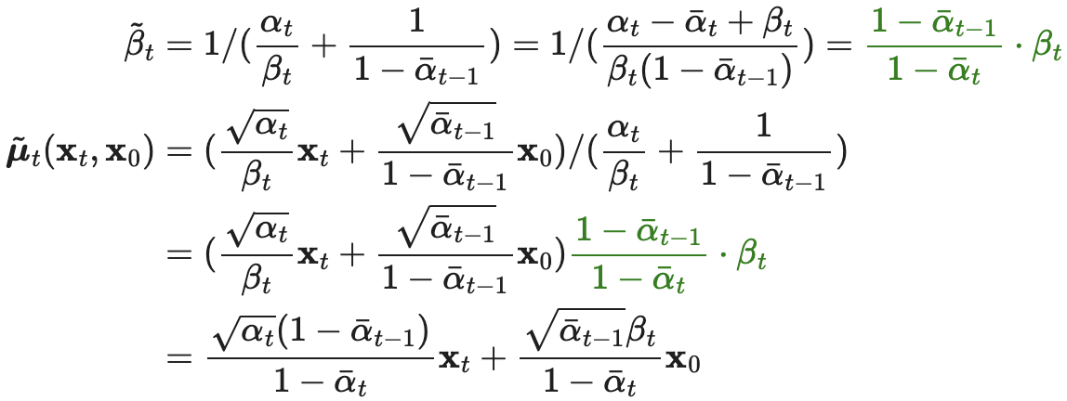
Background
Derivation of $q(x_{t}|x_{0})$ & $q(x_{t−1}|x_{t},x_{0})$
https://lilianweng.github.io/posts/2021-07-11-diffusion-models/
C&I LAB

Slide 15
Diffusion Models and Denoising Autoencoders
C&I LAB

Slide 16
Diffusion Models and Denoising Autoencoders
Manipulation on Objective Function
1
3
2
C&I LAB

Slide 17

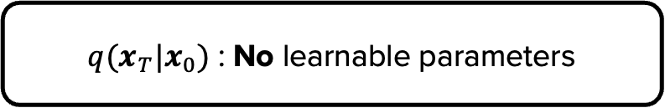
Diffusion Models and Denoising Autoencoders
Forward Process and $L_{T}$
$q(x_{T}|x_{0})$ : No learnable parameters
$L_{T}$ : Constant (or being ignored)
C&I LAB

Slide 18
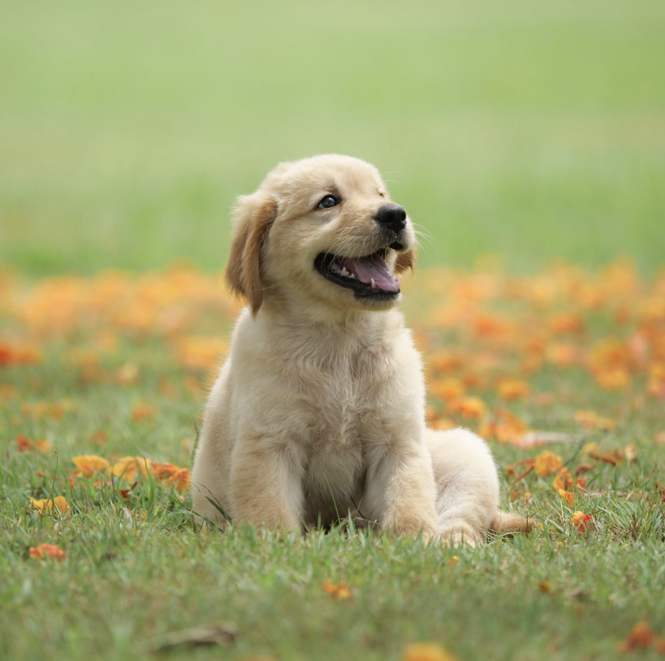
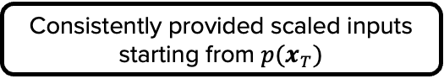

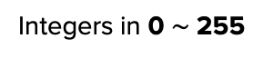
Diffusion Models and Denoising Autoencoders
Data Scaling, Reverse Process Decoder and $L_{0}$
Data Scaling Assumption
Integers in 0 $\sim$ 255
Linear Scaling
Consistently provided scaled inputs starting from $p(x_{T})$
-1 $\sim$ 1
Standard Normal Distribution
C&I LAB

Slide 19
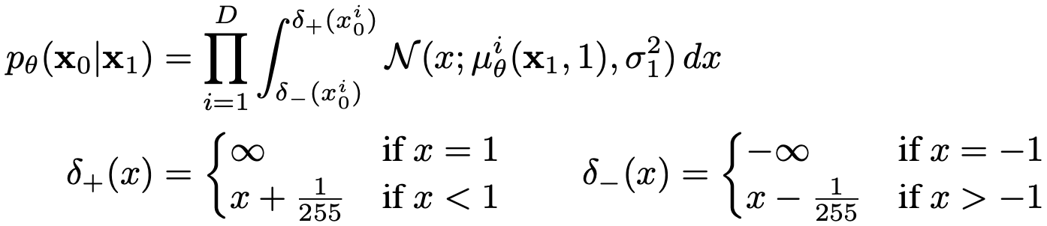
Diffusion Models and Denoising Autoencoders
Data Scaling, Reverse Process Decoder and $L_{0}$
[Independent Discrete Decoder derived from $𝒩(x_{0};μ_{θ}\left(x_{1},1\right),σ_{1}^{2}I)$]
Calculating discrete log-likelihood
→ Make sure all terms in the objective to differentiable with $θ$
C&I LAB

Slide 20
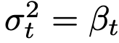
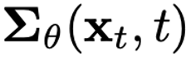
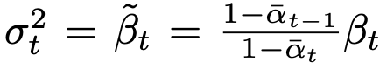
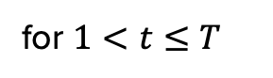
Diffusion Models and Denoising Autoencoders
Reverse Process and $L_{1:T−1}$
for $1<t≤T$
Similar Results
(1st option is adopted for this experiment)
C&I LAB

Slide 21
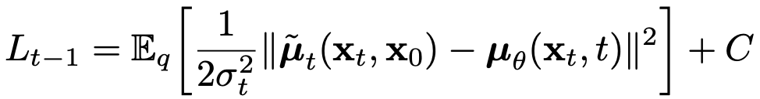
Diffusion Models and Denoising Autoencoders
Reverse Process and $L_{1:T−1}$
C&I LAB

Slide 22
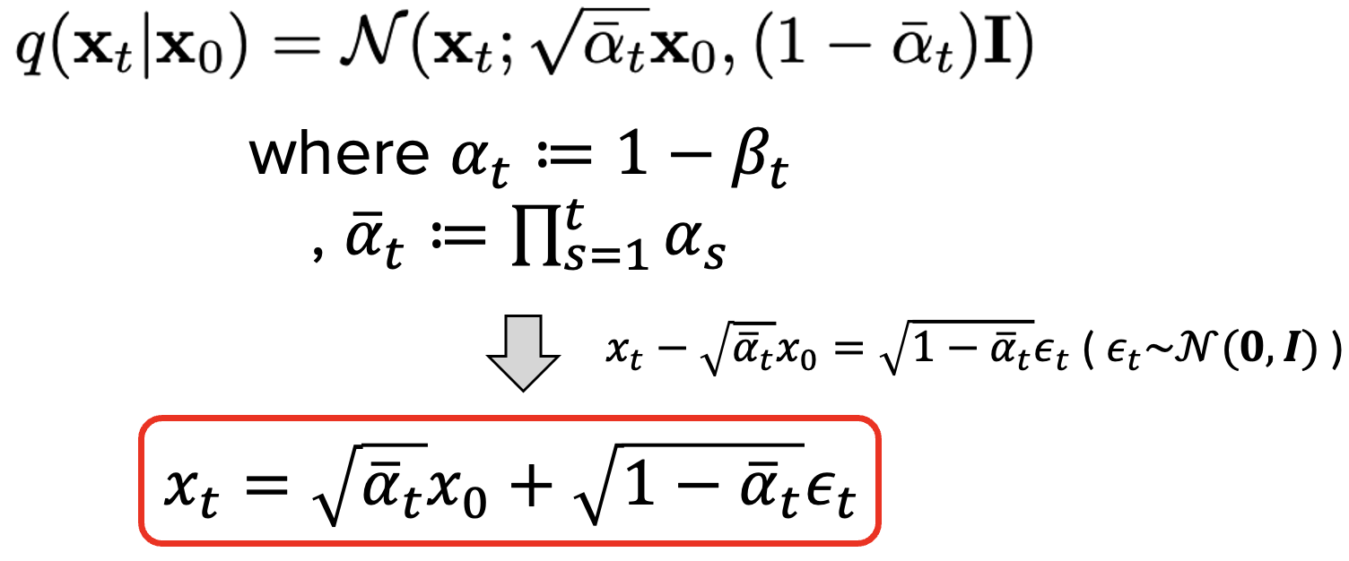
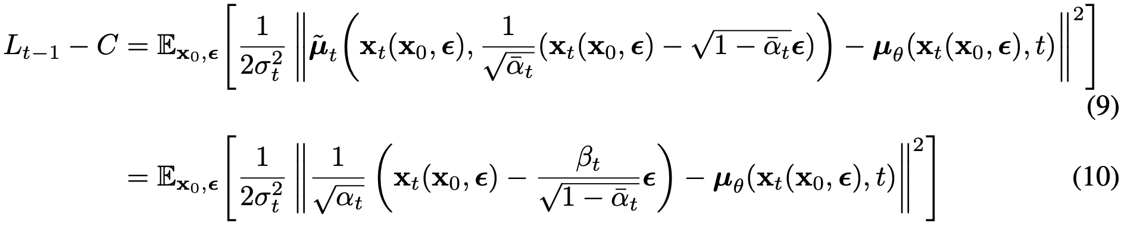
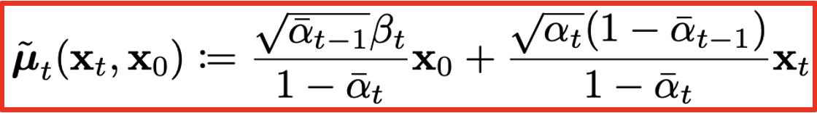
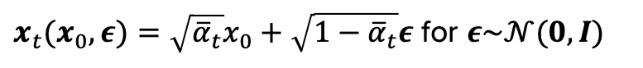
Diffusion Models and Denoising Autoencoders
Reverse Process and $L_{1:T−1}$
$x_{t}(x_{0},ε)=\sqrt{{\overline{α}}_{t}}x_{0}+\sqrt{{1−\overline{α}}_{t}}ε$ for $ε\sim 𝒩(0,I)$
C&I LAB

Slide 23
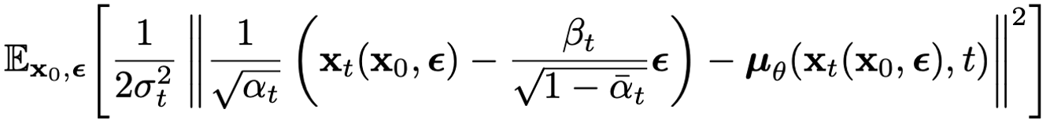
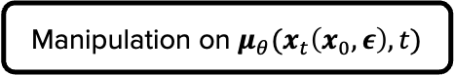
Diffusion Models and Denoising Autoencoders
Reverse Process and $L_{1:T−1}$
Manipulation on $μ_{θ}(x_{t}\left(x_{0},ε\right),t)$
Aim to predict the mean of posterior
$ε_{θ}(x_{t},t)$ : Predict $ε$ from $x_{t}$
C&I LAB

Slide 24
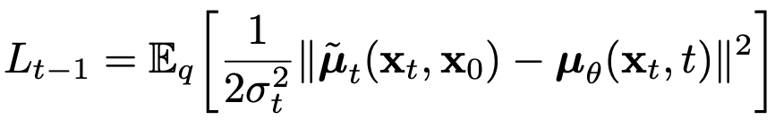
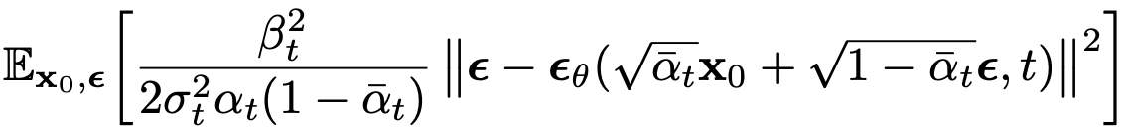
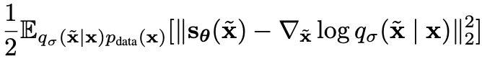
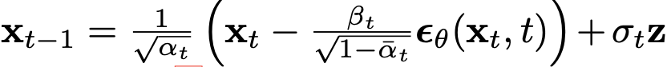
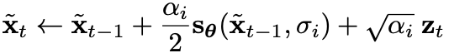
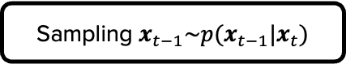
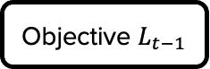

Diffusion Models and Denoising Autoencoders
Reverse Process and $L_{1:T−1}$
Objective $L_{t−1}$
Resembling Denoising Score Matching
Sampling $x_{t−1}\sim p(x_{t−1}|x_{t})$
Resembling Langevin Dynamics
$$z\sim 𝒩(0,I)$$
C&I LAB

Slide 25
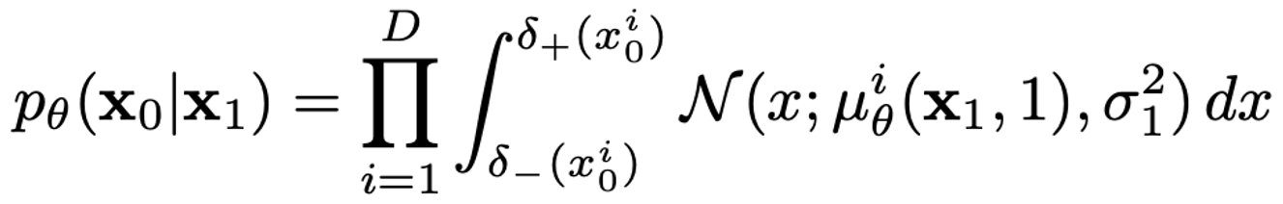
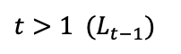
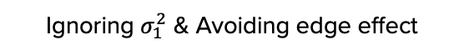
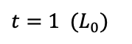
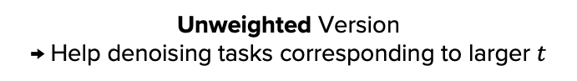
Diffusion Models and Denoising Autoencoders
Simplified Training Objective
$L_{0}, L_{t−1}$ : Differentiable with $θ$ ($L_{T}$ : Ignored)
$$t=1 (L_{0})$$
$$t>1 (L_{t−1})$$
Ignoring $σ_{1}^{2}$ & Avoiding edge effect
Unweighted Version
→ Help denoising tasks corresponding to larger $t$
C&I LAB

Slide 26
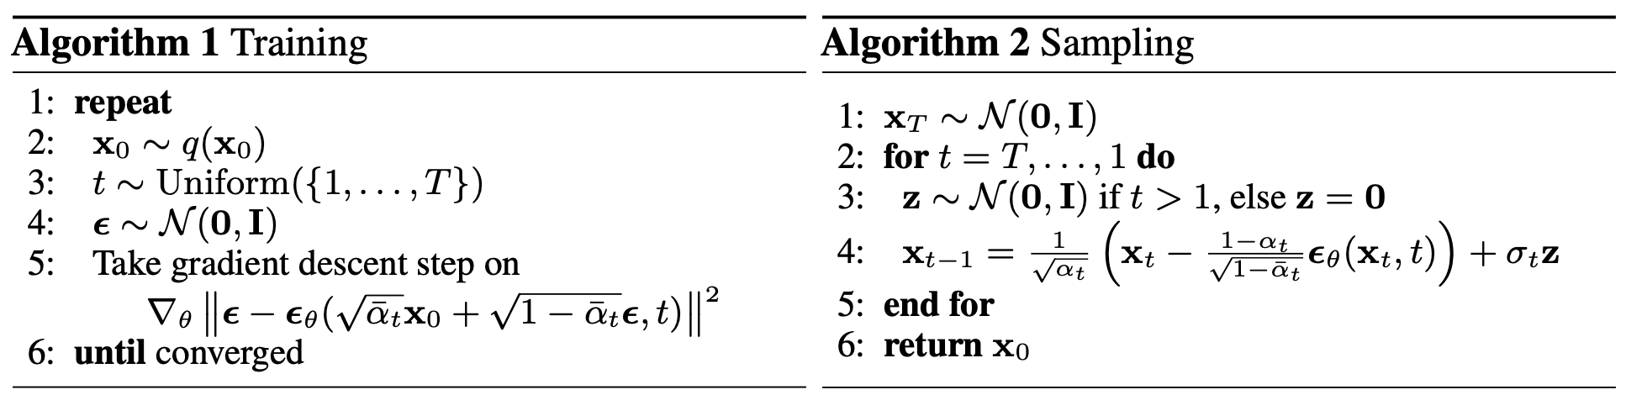
Diffusion Models and Denoising Autoencoders
Training & Sampling Algorithm
C&I LAB

Slide 27
Experiments
C&I LAB

Slide 28
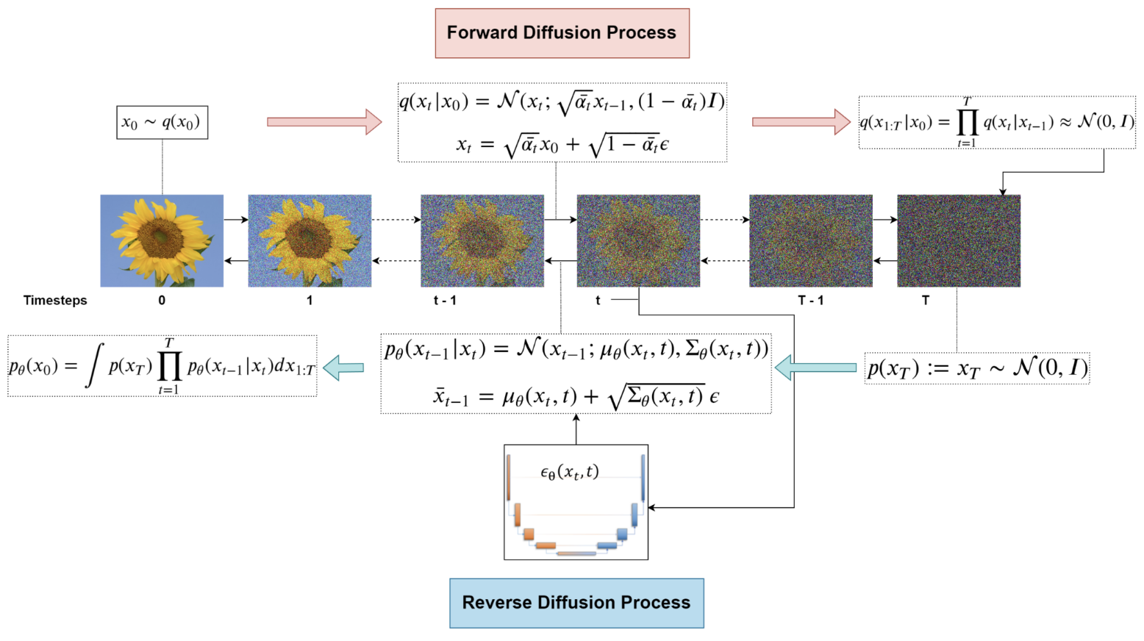
Experiments
Overall Procedure
https://learnopencv.com/denoising-diffusion-probabilistic-models/
C&I LAB

Slide 29
Experiments
Basic Setup for experiments
(Number of Sampling) “$T=1000$” → To compare with previous works
$β_{1}={10}^{−4}\sim β_{T}=0.02$ → Relatively small values for data scaled to $[−1, 1]$
Also ensuring forward process and reverse process have the same functional form
Reverse Process : Utilizing U-net Backbone
C&I LAB

Slide 30
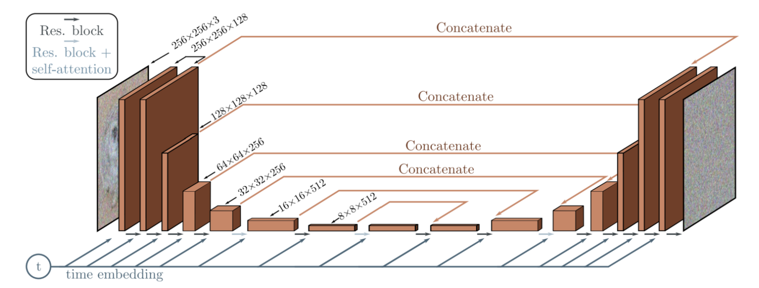
Experiments
Structure Description
https://learnopencv.com/denoising-diffusion-probabilistic-models/
C&I LAB

Slide 31
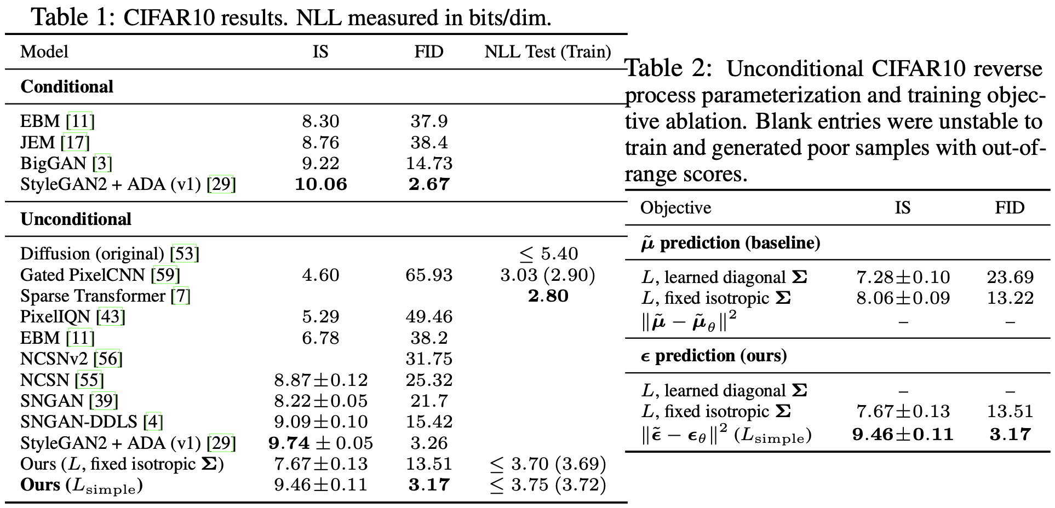
Experiments
Sample Quality
C&I LAB

Slide 32
Experiments
Sample Quality
Very small NLL gap between training data and test data → No overfitting
C&I LAB

Slide 33
Experiments
Progressive Lossy Compression
→ Rate
→ Distortion
1.78 bits/dim
1.97 bits/dim
More than half of codelength contributes to the distortion
C&I LAB

Slide 34
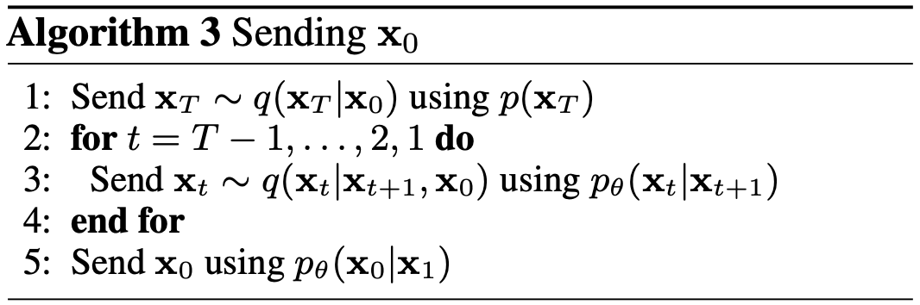
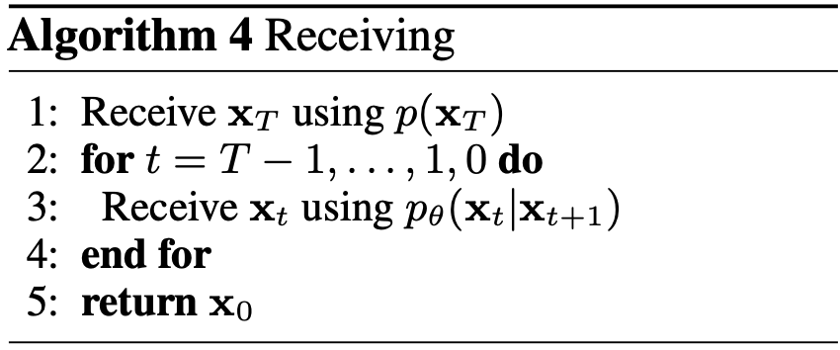
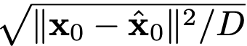
Experiments
Progressive Lossy Compression
Rate : Cumulative received bits until time $t$
Rate : Root Mean Squared Error
C&I LAB

Slide 35

Experiments
Progressive Lossy Compression
Steep Decline in low-rate region
→ Majority of bits are allocated to imperceptible distortions
C&I LAB

Slide 36



Experiments
Progressive Generation
Predicting the result of reverse process ${\hat{x}}_{0}$ while performing sampling
C&I LAB

Slide 37


Experiments
Progressive Generation
Stochastic Predictions $x_{0}\sim p_{θ}(x_{0}|x_{t})$ for various $t$
Focused on large scale features
All features and even fine details are captured
C&I LAB

Slide 38





Experiments
Interpolation
$$x_{0}$$
$${x′}_{0}$$
C&I LAB

Slide 39
Thank you
C&I LAB

